Slide 1
Annotation Quality
Team imported
Lóránd Heidrich
Gergő Márk Sere
Gergely Terényi
Diego Caparros Vaquer

Slide 2
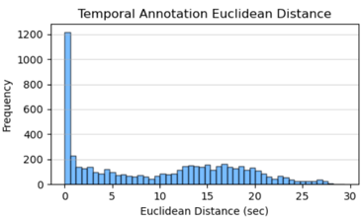
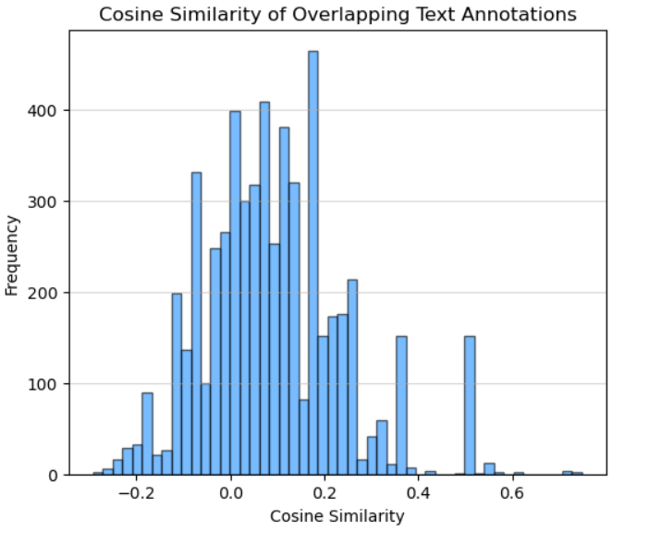
How similar are the text annotations that correspond to the same region?
How precise are the temporal annotations?
Majority agree on start/end time
Long positive skew with gradual decay
Euclidean distance: strong disagreement pattern (15-20 sec range)
Cosine similarity mostly 0-0.2 (mu=0.088, median=0.072)
Annotators utilize different wording for overlapping timespans
Notes:
How precise are the temporal annotations?
Temporal annotation precision was evaluated by comparing the onset and offset timings of overlapping regions from different annotators on the same audio file, considering only segments where a temporal overlap was present. The key metrics were Euclidean distance, onset and offset differences, and their means.
The results show a distinct spike around 0 sec, meaning the majority of annotators strongly agree on start and end times. All four distributions showed a long positive skew. While the onset and offset distributions show consistent gradual decay starting before the 5 second mark, the Euclidean distance analysis (visible in the top right corner of the slide) highlights a secondary hump in the 12-20 second range, indicating a stronger disagreement pattern here.
The results point to high general temporal precision, however, a significant amount of annotations do differ in timing, pointing to possible ambiguity in some of the audio that makes it harder to segment.
How similar are the text annotations that correspond to the same region?
Most overlapping annotations show low textual similarity across different annotators. The cosine similarities ranges from -0.29 – 0.75, with a mean of 0.088 and a median of 0.072, indicating that many annotators differ in their wording or focus. The histogram (visible on the bottom right) confirms this by showing a concentration of values between 0 and 0.2, suggesting generally weak agreement in textual descriptions even when annotators mark the same time span.

Slide 3
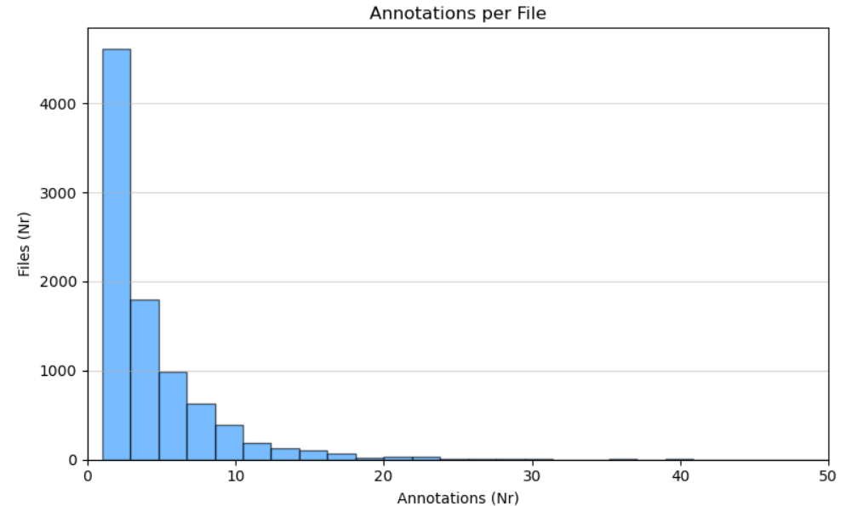
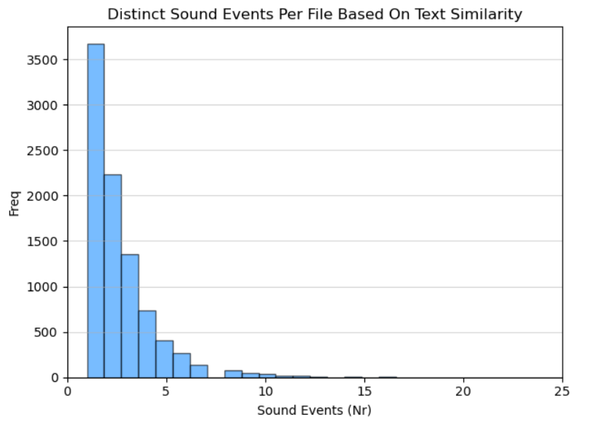
How many annotations did we collect per file? How many distinct sound events per file?
 | Annotations/File | Distinct Sound Events/File
Total Unique Files | 9026 | 9026
Total Annotations | 35826 | 35826
Mean | 3.9692 | 2.4253
Median | 2 | 2
STD | 4.4254 | 1.9063
Min | 1 | 1
Q1 | 1 | 1
Q2 | 2 | 2
Q3 | 5 | 3
Max | 96 | 27
Notes:
Annotations per File:
- Sharp peak at 1 annotation, quickly drops off.
- Over 4500 files have just 1 annotation.
- The frequency halves or more with each step up to 10.
- Beyond 15 annotations, files are rare.
- Distribution is heavily right-skewed with a long tail up to 96.
- Suggests that most files are sparsely annotated, but a few have dense annotation coverage.
Distinct Sound Events per File:
- Similar shape, peak at 1–2 events.
- About 3600 files have 1 event, then steep drop.
- Very few files have more than 10 distinct events.
- Max shown is ~23, again with a long tail.
- This suggests annotators often identified just a few unique events per file, even when multiple annotations were present.

Slide 4
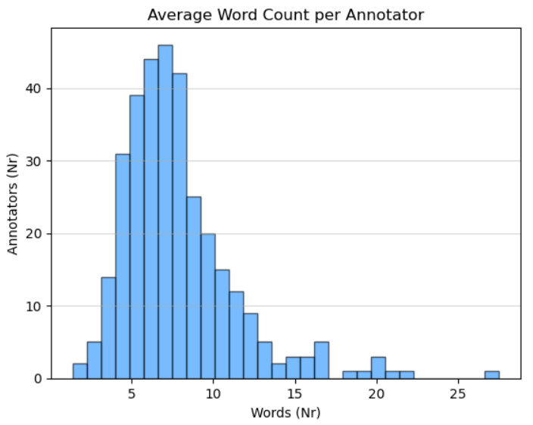
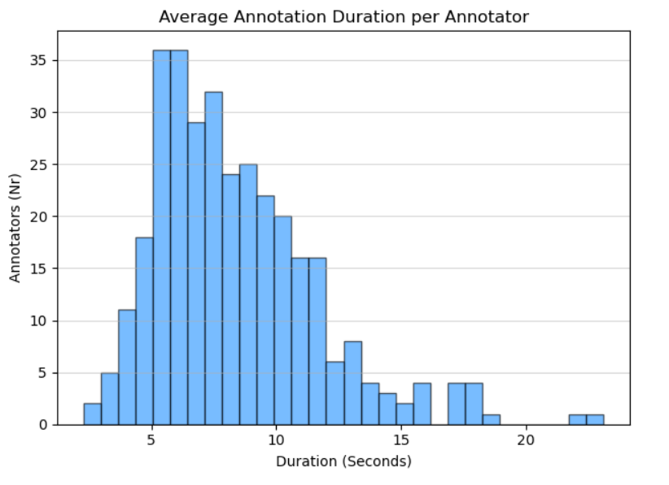
How detailed are the text annotations? How much does the quality of annotations vary between
different annotators?
Average annotation = 7.85 words, average duration = 8.38 sec
Big differences across annotators: some use >20 words or long segments
5-10 sec and 5-10 word range is most common
Notes:
The annotations have an average word count of 7.85 word. The histogram (on the left) shows a concentration between 5-10 words (a reasonable amount considering the annotation guidelines), however some annotators averaged over 20 words. The positive skew is indicative of this high variability.
For annotation duration (on the right), most annotators marked events lasting in the 5-10 second range, with an overall average of 8.38 sec. The distribution’s long tail indicates some annotators consistently marked longer events, ranging over 20 seconds, indicating a difference in how annotators perceive events. The standard deviation of 3.31 seconds indicates moderate variation in the average durations used by different annotators.

Slide 5
Are there any obvious inconsistencies, outliers, or poor-quality annotations in the data? Propose a
simple method to filter or fix annotations
15.25%–22.14% flagged poor using duration, word count, and spelling
26.6% of annotations under 5 words
3% had over 3 spelling mistakes, 49.56% had none
Proposed filter:
Flag extreme durations
Flag short annotation texts
Check spelling with pyspellchecker
Duration Outcomes | IQR | 99% | 95%
Text too short (annotations) | 0 | 355 | 1792
Text too long (annotations) | 0 | 359 | 1792
Text too short (%) | 0% | 0.9909% | 5.0020%
Text too long (%) | 0% | 1.0021% | 5.0020%
Word Count Outcomes | 1% | 5% | IQR Lower | Explicit 5
Word threshold | 2 | 2 | -3.5 | 5
Annotation Count | 335 | 335 | 0 | 9537
Annotation Proportion | 0.9351% | 0.9351% | 0% | 26.6203%
Notes:
Annotation duration, word count, and spelling errors were the indicators used to detect inconsistencies, outliers, and poor-quality annotations. Outlier thresholds were set both by IQR and explicit selection, following best practices and empirical testing.
Event duration markers (top table) found no IQR lower outliers, therefore the central range is wide and tolerant. Explicit 1% / 99% thresholds flagged 0.99% / 1% of annotations respectively, while 5% / 95% thresholds flagged 5% each, showing that most annotations are reasonable, with few consistent outliers.
Text description length (bottom table), identified by word counts per annotation also found no lower outliers by IQR threshold. Percentile thresholds flagged 0.94% of annotations under the fifth percentile. Explicit counts found no zero-word annotations, 335 one-word, 2024 two-word, and 3146 three-word annotations. A total of 9537 annotations, marking 26.62% of the population were under the five-word threshold, arbitrarily found to be ideal for describing annotations based on the guidelines, potentially marking a large portion of the population as poor.
Spelling was measured with Python’s pyspellchecker module to gauge effort and commitment to the task. 49.56% of annotations had no spelling errors. 32.3% had one misspelled word, nearly 15% had 2-3 misspelled words, leaving around 3% with 4 or more misspelled words.
Combining all three criteria, with duration (below 1% or above 99%), short text (≤2 word count), and a high misspell count (≥3), 15.25% of annotations were flagged as having poor quality. Using a 5% duration threshold raised this to 22.14%.
Proposition:
Spelling errors can be fixed programmatically, flagging the annotation for review. Word count and duration outliers can be flagged in the same manner. A random sample of this subset will reveal the possible necessity of reannotating these flagged files. If necessary, the group of files can be reassigned to their respective annotators.

